Slide 1
Will a scheduled ride arrive on-time?
Bob Newstadt
Springboard.com Intermediate Data Science Course
December 2018
Mentor: Hobson Lane

Slide 2
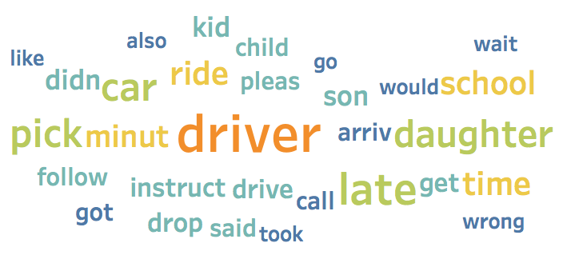
Customers complain most about drivers being late!

Slide 3
What can data science tell us?
Which rides will be on-time?
What are the principal causes of late arrivals?

Slide 4
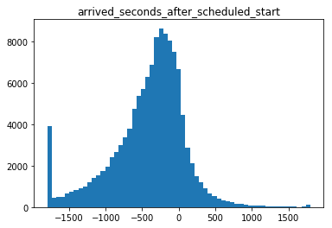
Framing the prediction problem
What to predict:
the relative arrival time
zero is on-time. Above zero is arriving late.
When to predict:
1 hour before the scheduled start of the ride
approx. when the driver checks in
8.5
Minutes Early on Average
Notes:
Predicting a continuous numeric value requires a regression model as opposed to a classification model.
Target is: (origin_arrived_at_pdt - scheduled_starts_at_pdt) in seconds saturated to +/- 30 minutes.
An hour before the scheduled start is enough time for a successful intervention if needed.

Slide 5
The data set has over 200,000 trips x 74 attributes
10 attributes are identifiers
lead_organizer_id, passengers_ids, driver_id, etc...
20 attributes are geographic locations
metro_area_name, region, zip codes, lat, lon, etc....
11 attributes are timestamps
created_at_pdt, scheduled_starts_at_pdt, etc…
Notes:
The data was anonymized for privacy

Slide 6
Let’s build a model in 6 easy steps!
Choose supervised or unsupervised learning
We’ll use the known lateness for each trip to supervise the machine learning.
Choose regression or classification
We’ll predict lateness, a continuous value; that’s regression.
Prepare the data
Convert data to numeric values; Deal with missing values; Engineer new features.
Reserve some of the data for testing
We’ll use 80% of the data for training and 20% for testing.
Fit a model on the training data
Select an algorithm, supply hyper parameters, fit the model.
Evaluate the model on the testing data
Our performance metrics were “explained variance score” and “median absolute error”.
Repeat

Slide 7
The winning model …
Explained 22% of the variance in lateness.
Predicted lateness with a median error of ±4 minutes.
Used a “Gradient Boosting Regressor”
an ensemble of 200 estimators
a maximum feature depth of 4
selecting from 209 base features

Slide 8
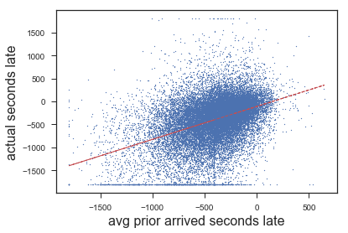
A driver’s prior lateness is predictive of future lateness

Slide 9
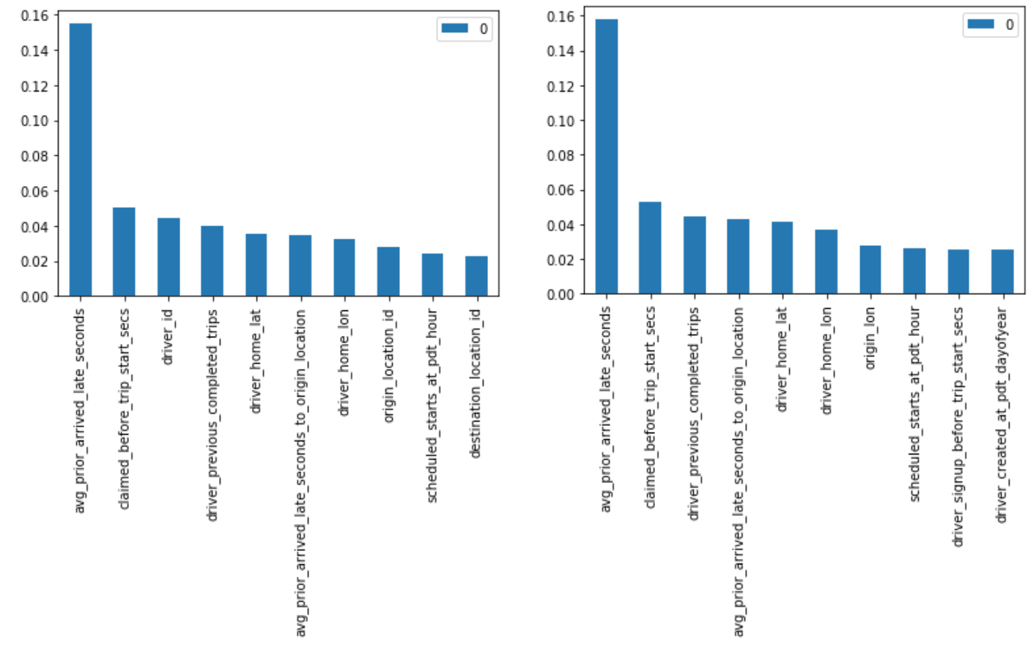
Model generalized better after identifier features removed.
Top Features
Before IDs Excluded
Top Features
After IDs Excluded

Slide 10
The 2 principal causes of lateness
The Driver
Many of the most important features reflected the driver’s past performance, the driver’s experience, and the driver’s location.
Driver Replacement
The models discovered that drivers who claim rides in the hour before the scheduled start are more likely to be late. Many of these claims are last-minute driver replacements.

Slide 11
Recommended Actions
The Driver
Help drivers manage their schedules and locations.
Driver training improvements may also help.
Driver Replacement
Help drivers avoid being replaced.
Investigate the root causes of driver replacement.
Training, feedback, and incentives should be considered.
Notes:
May need to collect more data about where the driver is.

Slide 12



Learn More
Jupyter notebooks and full report in my github repository https://github.com/b-i-bob/trips_springboard_data_science

